Slide 1

UNIT 1
Object – Oriented Programming (Java)
Dr. Debabrata Swain
Department of Computer Science & Engineering
Pandit Deendayal Energy University

Slide 2

Dedicated to Lord Jagannath

Slide 3

About You?
3rd semester @ PDEU!
New Department, New friends. New teachers. New subjects.
Know each other
Become a special class – individually and collectively
CR? Mobile? Email?

Slide 4
About Me
B.Tech,CSE (BPUT, Odisha)
M.Tech,CSE (Berhampur Universiy, Odisha)
PhD (KIIT, Odisha) (Deep Learning)
debabrata.swain@sot.pdpu.ac.in
• 9420282817
Office: E215

Slide 5



Slide 6

What I Appreciate
Two-way interaction
100% attention
You are where your mind is
Laugh when I crack jokes ☺
Be regular in attendance and in self-study
Ask questions
Be punctual in class
Learning is serious fun

Slide 7

What I Do Not Appreciate
Mobile phones
Talking in class
No non-sense business, everything else is fine
Teacher is smarter than the students, though students always think otherwise ☺
Coming late
Doing something else in my class
Missing classes

Slide 8
Syllabus
UNIT 1 BASICS OF JAVA
Features of Object Oriented Programming and Java, Basics of Java programming, Data types, Variables, Operators,
Control structures including selection, Looping, Java methods, Overloading, Math class, Arrays in java.
7 Hrs.
UNIT 2 INHERITANCE
Basics of objects and classes in java, Constructors, Visibility modifiers, Inbuilt classes in Java, this reference; Inheritance in
java, Overriding, Object class, Polymorphism, Dynamic binding, Abstract class, Interface in java, Package in java.
7 Hrs.
UNIT 3 I/O PROGRAMMING, EXCEPTION AND MULTITHREADING
Introduction to Java IO streams, Character and Binary streams, reading data from and writing data to files, Difference
between error and exception, Exception handling in Java, Multithreading in Java, Thread life cycle and methods, Runnable
interface, Thread synchronization
6 Hrs.
UNIT 4 EVENT HANDLING AND GUI PROGRAMMING
Event handling in Java, GUI Components and Layouts, Applet and its life cycle.
6 Hrs.
Max. 26 Hrs.

Slide 9
What is this course all about?
COURSE OUTCOMES
On completion of the course, student will be able to
CO1- Describe the basic features of Obejct-oriented programming and map them with the Java.
CO2- Distinguish Objects and Classes using Java.
CO3- Demonstrate Inheritance and Runtime Polymorphism
CO4- Apply I/O handling, exception handling for interactive problem.
CO5- Use the concepts of Event Handling in GUI Programming.
CO6- Construct object-oriented solutions for small systems involving multiple objects.

Slide 10

What is this course all about?

Slide 11
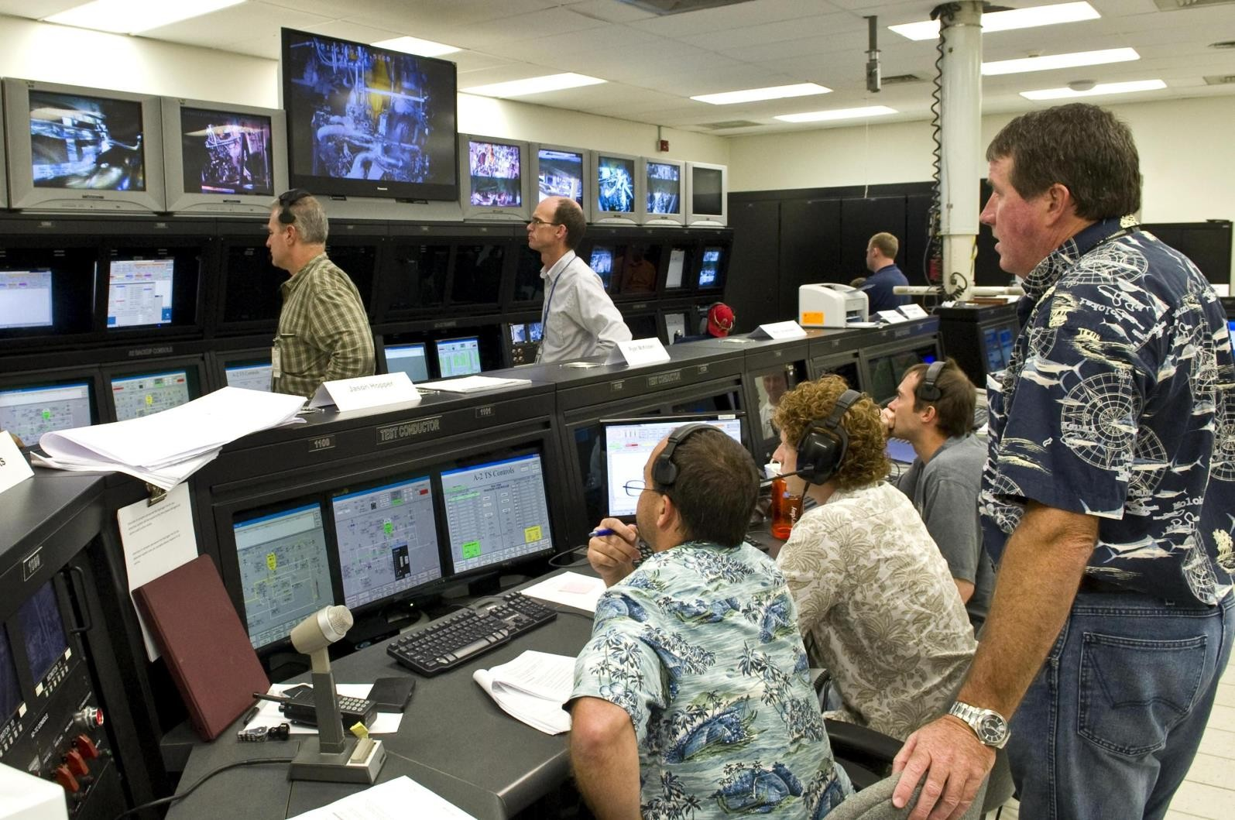
What is this course all about?

Slide 12
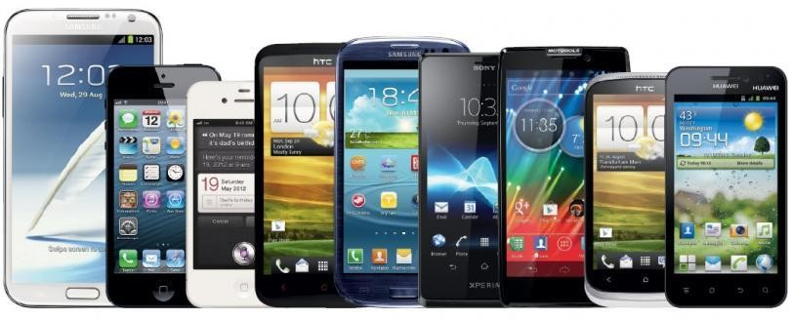




What is this course all about?

Slide 13
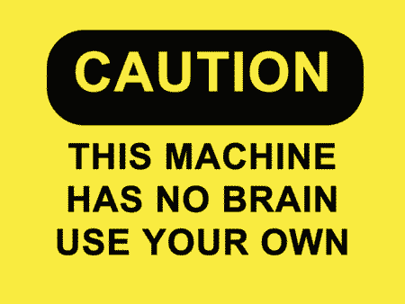


What is this course all about?

Slide 14


What is this course all about?

Slide 15

What I expect from you?
Take responsibility for your learning

Slide 16

What I expect from you?
Be proactive
Solve as many problems as you can
Practice! Practice!
Labs are very important
Ask questions
Please take notes of important points

Slide 17
Text Books
1. Brett D. McLaughlin, Head First Object-Oriented Analysis and Design, O Reilly, 2006
2. Matt Weisfeld, The Object-Oriented Thought Process, Addison-Wesley Professional, 2019
3. Herbert Schild, The Complete Reference, Java 2, McGraw Hill, 2018
4. Balaguruswamy, Programming with Java – A Primer, McGraw Hill, 2019

Slide 18
Introduction to JAVA
The Java language was designed at Sun Microsystems, first release in January 1995.
James Gosling, Man behind the project.
Need : Platform Independence
Difference in HARDWARE on where the programs are DEVELOPED AND EXECUTED.
Over the years, Internet Took over the demands of embedded systems.

Slide 19
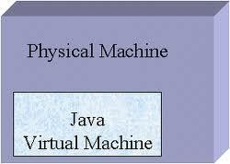


JAVA language and JVM
While the team may have originally had in mind developing a language which can work for multiple processor.
Instead they developed both the JAVA language and a virtual processor called the Java Virtual Machine or JVM.
Java program

Slide 20
Java : Characteristics
Descendent of C/C++ Family
Simple : Easy to learn and code
Portable/Architecture-Neutral
Object Oriented
Secure
Robust : Does not allow user to write erroneous programs. It poses strict restrictions.
Multithreaded
Interpreted and and High Performance
Distributed
Dynamic

Slide 21



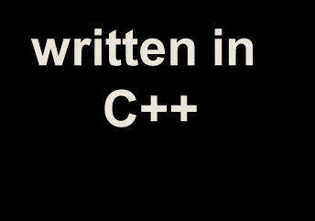






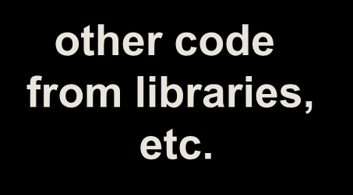
C/C++ Program Execution Stages
myprog.cpp myprog.obj
SOURCE OBJECT
myprog.exe
EXECUTABLE
written in C++
Machine Language code
Executable code
via compiler
via linker
other code from libraries, etc.

Slide 22
How a JAVA Program is Executed

Slide 23
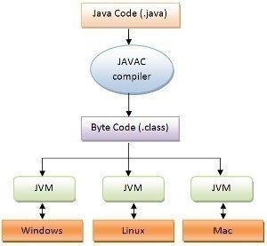
Compilation
Any Java Application is nothing but a bunch of .class files
This is Not specific to any machine
JVM for each machine is separate
Interpreted

Slide 24
JAVA Compiler
A Java compiler is a program which converts Java source code into Java byte-code or class files.
A basic Java compiler is included as part of the JDK (Java Development Kit). This Java compiler is called “javac”.
Unless you have installed JDK for your system “javac” will not be recognized.

Slide 25
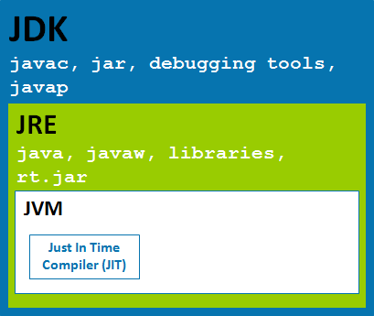

Slide 26


JAVA Bytecode
Java bytecode is produced by the Java compiler and executed by the JVM (Java Virtual Machine).
Java bytecode isn’t exactly source code, and it isn’t exactly compiled code, it’s something in the middle.

Slide 27
Java Virtual Machine
Java Virtual Machine : Main component responsible for JAVA to be platform independent.
A JVM provides a runtime environment to execute Java bytecode.
Translates a single instruction from the Byte- code program to machine language and immediately runs it, one at a time.

Slide 28
Java Virtual Machine
Whenever a JAVA application is required to be executed, an instance of JVM is loaded on to the RAM of the native machine and takes the responsibility of the execution.
JVM is not actually a hardware but resides in the RAM whenever a JAVA code is to be executed.
Provides Features such as
Automated exception handling
Control loader
Just-in-time compiler
Byte-code verifying.

Slide 29
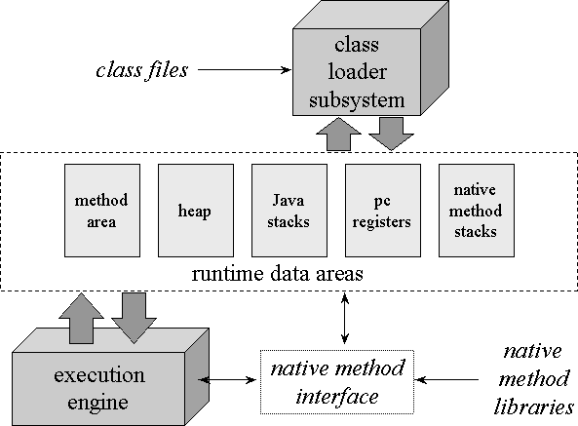
The internal architecture of the Java virtual machine

Slide 30
Starting With JAVA
Install JDK for your system.
Check if JDK is installed properly:
java -version

Slide 31
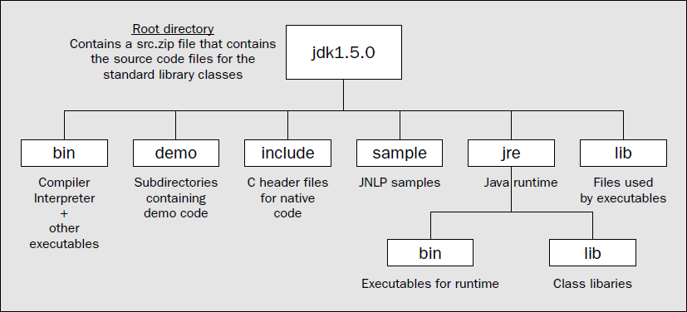

Slide 32
Executing your JAVA program
Using CMD

Slide 33
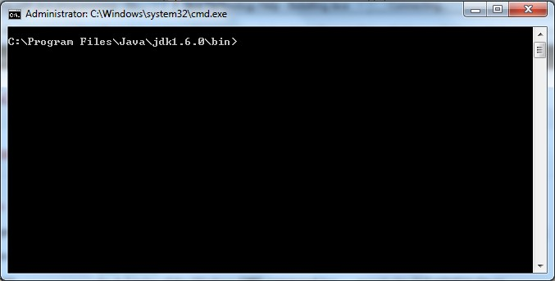
Get into the Folder

Slide 34
First JAVA Program
class ABC
{
public static void main(String args[])
{
System.out.println(“Hello World”);
}
}

Slide 35
First Java Program
public class ABC
{
public static void main(String args[])
{
System.out.println("First Java prog”);
}
}
Save inside a file named ABC.java
To compile: javac ABC.java (produces ABC.class)
To execute: java ABC (executes ABC.class) Output: First Java prog

Slide 36
Why/How the program executes from Main method?
What happens at linking.?
One or more object files or libraries are combined to produce a single (executable) file.
In doing so, it does lot of binding such as,
Function names to their addresses (Different files)
This is also the time that a special symbol MAIN is searched out.

Slide 37
How MAIN is recognized in JAVA?

Slide 38
Find out the Error? public class ClassA {
int a;
public ClassA() {
a = 10;
}
public static void main2(String[] args) {
ClassA a = new ClassA();
}
}
a. Compile time b. Runtime c. Linking error d. No error

Slide 39
How main is recognized in Java
JVM will create as many as class files as there are classes in the file .java.
However, MAIN Method has to be the part of the class file which is same as the name of the File
.java.
It will execute the code from that main method.

Slide 40
Syntax for MAIN method
public static void main(String args[])
public : So that it can be accessed by anywhere in any classes.
static : No object is required to invoke the main method.
void : No return type
String args[] : arguments to main method at the time of invocation

Slide 41
First Java Program
class ABC
{
public static void main(String args[])
{
System.out.println("First Java prog"+
args[0]);
}
}
java ABC 123 Output:
First Java prog123

Slide 42
Dynamic Linking
This is used by the Java interpreter to launch the program by invoking the main method of the class identified in the command to start the program.
All address resolution is done at runtime by JVM.
This is, Dynamic Linking
JVM calls main () method using its Classname.main () at the time of running the program.
Main need to be public to be accessed by JVM.

Slide 43
Primitive Data Types in JAVA
Data Type | Memory Size | Default value | Declaration
byte | 8 bits | 0 | byte a=9;
short | 16 bits | 0 | short b=89;
int | 32 bits | 0 | int c=8789;
long | 64 bits | 0 | long=9878688;
float | 32 bits | 0.0f | float b=89.8f;
double | 64 bits | 0.0 | double c =87.098
char | 16 bits | 'u0000' | char a ='e';
boolean | JVM Dependent | false | boolean a =true;

Slide 44
Java Variables
A variable is a container which holds the value while the Java program is executed. A variable is assigned with a data type.
Variable is a name of memory location. There are three types of variables in java: local, instance and static.
There are two types of data types in Java: primitive and non-primitive.
A variable is the name of a reserved area allocated in memory. In other words, it is a name of the memory location. It is a combination of "vary + able" which means its value can be changed.

Slide 45
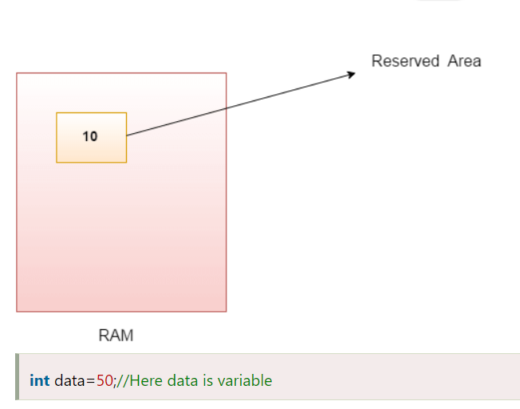

Slide 46
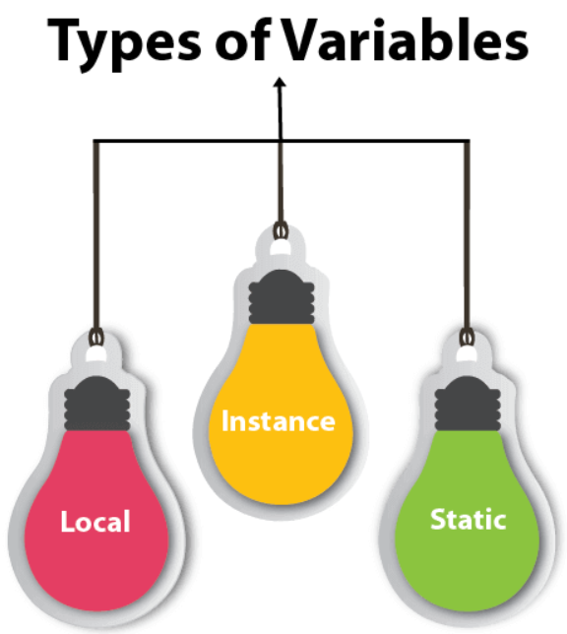
Types of Variables
There are three types of variables in Java:
local variable
instance variable
static variable

Slide 47
1) Local Variable
A variable declared inside the body of the method is called local variable. You can use this variable only within that method and the other methods in the class aren't even aware that the variable exists.
A local variable cannot be defined with "static" keyword.
2) Instance Variable
A variable declared inside the class but outside the body of the method, is called an instance variable. It is not declared as static.
It is called an instance variable because its value is instance-specific and is not shared among instances.
3) Static variable
A variable that is declared as static is called a static variable. It cannot be local. You can create a single copy of the static variable and share it among all the instances of the class. Memory allocation for static variables happens only once when the class is loaded in the memory.

Slide 48
Ex-
public class A
{
static int m=100;//static variable
int data1;//instance variable
void method()
{
int n=90;//local variable
}
public static void main(String args[])
{
int data=50;//instance variable
method();
}
}//end of class

Slide 49
Java Variable Example: Widening
public class Simple{
public static void main(String[] args){
int a=10;
float f=a;
System.out.println(a);
System.out.println(f);
}}
O/P-
10
10.0

Slide 50
Java Variable Example: Narrowing (Typecasting)
public class Simple{
public static void main(String[] args){
float f=10.5f;
//int a=f;//Compile time error
int a=(int)f;
System.out.println(f);
System.out.println(a);
}}
O/P-
10.5
10

Slide 51
Java Variable Example: Overflow
class Simple{
public static void main(String[] args){
//Overflow
int a=130;
byte b=(byte)a;
System.out.println(a);
System.out.println(b);
}}
O/P-
130
-126

Slide 52
Java Variable Example: Adding Lower Type
class Simple{
public static void main(String[] args){
byte a=10;
byte b=10;
//byte c=a+b;//Compile Time Error:
//because a+b=20 will be int
byte c=(byte)(a+b);
System.out.println(c);
}}
O/P-
20

Slide 53
Arrays
One-Dimensional Arrays
Declaration
type var-name[ ];
e.g. int x[];
No memory is allocated at this point infact it is set to null.
Allocating Memory;
var_name = new type[size];
e.g. x= new int[10];
Two-Dimensional Array
E.g int x[][]=new int[5][5];

Slide 54
Alternative Array Declaration Syntax
int al[] = new int[3];
int[] a2 = new int[3];
char twod1[][] = new char[3][4];
char[][] twod2 = new char[3][4];

Slide 55
Conditional
Only if- checks only a single condition and do a single task if the given condition is true.
if(age>18) //only if
System.out.println(“Adult”);
if-else // 2 alternatives
if(cond)
St-1
else
St-2

Slide 56
Nested If-else- multiple options/ statements
if(cond1)
if(cond2)
St1
else
St2
else
St3
o/p- Cond1-T, Cond2-T --- St1
T F --- St2
F NA --- St3

Slide 57
Ladder if- else (multiple options/ statements)
if(condition)
{
//some code for if part
}
else if(condition)
{
//some code for else if part
}
else
{
//some code for else part
}

Slide 58
Loops
A Loop is an iterative statement that executes a single or block of statements till a particular condition is true.

Slide 59
Iteration Statements
While loop :-
while(condition) {
// body of loop
}
Do – while loop :-
do{
//body of loop
}while(condition)
For Loop :-
for(initialization1 ; condition2 ; updation3){
4//body of loop
}1243243243243

Slide 60
For-Each Loop
It starts with the keyword for like a normal for-loop.
Instead of declaring and initializing a loop counter variable, you declare a variable that is the same type as the base type of the array, followed by a colon, which is then followed by the array name.
In the loop body, you can use the loop variable you created rather than using an indexed array element.
It’s commonly used to iterate over an array or a Collections class (eg, ArrayList)

Slide 61
Syntax:
for (type var : array)
{
statements using var;
}
is equivalent to:
for (int i=0; i<arr.length; i++)
{
type var = arr[i];
statements using var;
}

Slide 62
// Java program to illustrate
// for-each loop
class For_Each
{
public static void main(String[] arg)
{
{
int[] marks = { 125, 132, 95, 116, 110 };
int highest_marks = maximum(marks);
System.out.println("The highest score is " + highest_marks);
}
}
public static int maximum(int[] numbers)
{
int maxSoFar = numbers[0];
// for each loop
for (int num : numbers)
{
if (num > maxSoFar)
{
maxSoFar = num;
}
}
return maxSoFar;
}
}

Slide 63
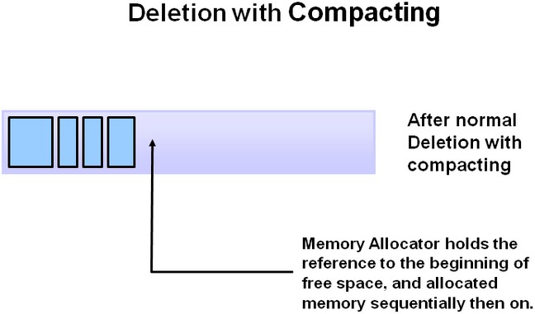

Slide 64
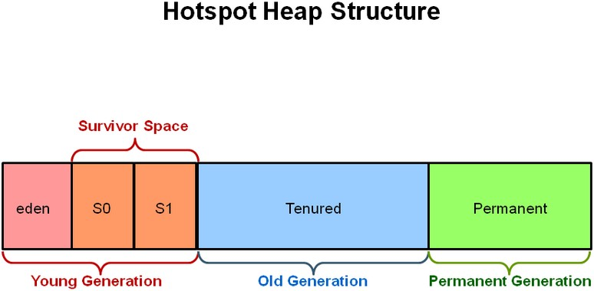
Generation Garbage Collection

Slide 65
MCQs
What is the output of the following program? class MyClass
{
public static void main(String[] args)
{
int x; x=test();
System.out.println("x="+x);
}
static int test()
{
System.out.println("Inside Test()");
}
}
Inside Test() x=0
Compilation Error
None of the Above
OUTPUT:
B. Compilation error

Slide 66
Which three are legal array declarations?
int [] myScores [];
char [] myChars; int [6] myScores; Dog myDogs []; Dog myDogs [7];
Correct Option:- A
A. 1, 2, 4
C. 2, 3, 4
B. 2, 4, 5
D. All are correct.

Slide 67
Which is the valid declarations within an interface definition?
public double methodA();
public final double methodA();
static void methodA(double d1);
protected void methodA(double d1);
Correct Option:- A

Slide 68
What is process of defining two or more methods within same class that have same name but different parameters declaration?
method overriding
method overloading
method hiding
None of the mentioned
Correct Option:-B

Slide 69
Which of the following statements are incorrect?
Default constructor is called at the time of creation of the object if a constructor has not been defined.
Constructor can be parameterized.
finalize() method is called when a object goes out of scope and is no longer needed.
finalize() method must be declared protected.
Correct Option:- C

Slide 70
int z,x=5,y=-10,b=2; z=x++ - - - y/b;
What will be the value of z?
20
10
11
5
Correct Answer : b

Slide 71
class overload {
int x;
int y;
void add(int a) { x = a + 1;
}
void add(int a, int b){
x = a + 2;
}
}
class Overload_methods {
public static void main(String args[])
{
overload obj = new overload();
int a = 0;
obj.add(6);
System.out.println(obj.x);
}
}
What is the output of this program?
5
6
7
8
Correct Option:- C

Slide 72
class test {
int a;
int b;
test(int i, int j) { a = i;
b = j;
}
void meth(test o) {
*= 2;
/= 2;
}
class Output {
public static void main(String args[])
{
test b1 = new test(10, 20); test b2 = new test(10, 20); b1.math(b2);
System.out.println(b2.a+” ”+b2.b);
}
}
}
What is the output of this program? a) 10 20
b) 20 10
c) 20 40
d) 40 20
Correct Option:- b

Slide 73
public class Trial {
public static void main(String[] args)
{
hello();
}
void hello()
{
System.out.println(“Hello World");
}
Correct Answer : B
non-static method test() cannot be referenced from a static context
}
What will be the output of above program?
Hello World
Compilation Error
None of the Above

Slide 74
Thank you

